Slide 1


ClaimSure
Claims Fraud Triage Copilot
A Conversational AI agent for claims fraud detection, developed through Snowflake Cortex.
Snowflake Cortex
AI engine for intelligent code execution & LLM reasoning
Streamlit in Snowflake
Interactive conversational UI built directly inside Snowflake
Claims Fraud Detection
Automated triage, anomaly scoring & policy inspection
TEAM NAME
SnowNexus
TEAM MEMBERS
Aniket Jain • Akshaya Jayakumar
Udit Saini • Peruri Mohana Satya
⚡ Claims Fraud Triage Copilot | Powered by Snowflake Cortex

Slide 2

Problem Statement & Why It Matters
THE CHALLENGE TODAY
storage
description
help_outline
balance
Data Locked in Tables
Claim amount, fraud score, and policy status sit in database tables business users can't query directly.
Contracts Nobody Rereads
Coverage and exclusion clauses live in long PDFs nobody has time to fully re-read per claim.
Unknown Data Trust
Is the underlying data reliable this week? Usually only the data engineering team knows.
No Risk Triage
Every claim is queued equally, regardless of risk — no way to fast-track the low-risk majority.
Why It Matters
By unifying claims data, policy documents, and data-quality signals into a single Cortex Agent, adjusters and business users can investigate fraud using plain English. This eliminates the need for SQL queries, manual PDF reviews, or waiting on data engineering to verify data accuracy. The result is faster payouts for clean claims, reduced risk of missed exclusions, and a scalable Cortex Agents pattern that can be expanded to other claims workflows without additional infrastructure.
⚡ Every minute spent re-reading a policy is a minute not spent on the claim that actually needs it.

Slide 3
Proposed Solution - AI Powered Copilot
A unified AI assistant built on Snowflake Cortex features that helps insurance claims adjusters fast-track honest claims and focus investigation on suspicious ones.
01 · Cortex Analyst
02 · Cortex Search
03 · Cortex Complete
Self-Service Analytics
Ask business questions in plain English — no SQL or BI dashboard needed.
Document Intelligence
Ask what a policy covers or excludes — answered from the actual contract text.
Data Quality Root Cause
Ask why a metric looks off — get a plain-English explanation, not just a score.
How It Works
Business User
Asks a Question
Cortex Agent
Routes the Request
Specialist Responds
with Grounded Answer
Adjuster / Analyst
Takes Action
⚡ One agent, three Cortex specialists — not three separate tools. An orchestrating Cortex Agent reads each question and routes it automatically.

Slide 4
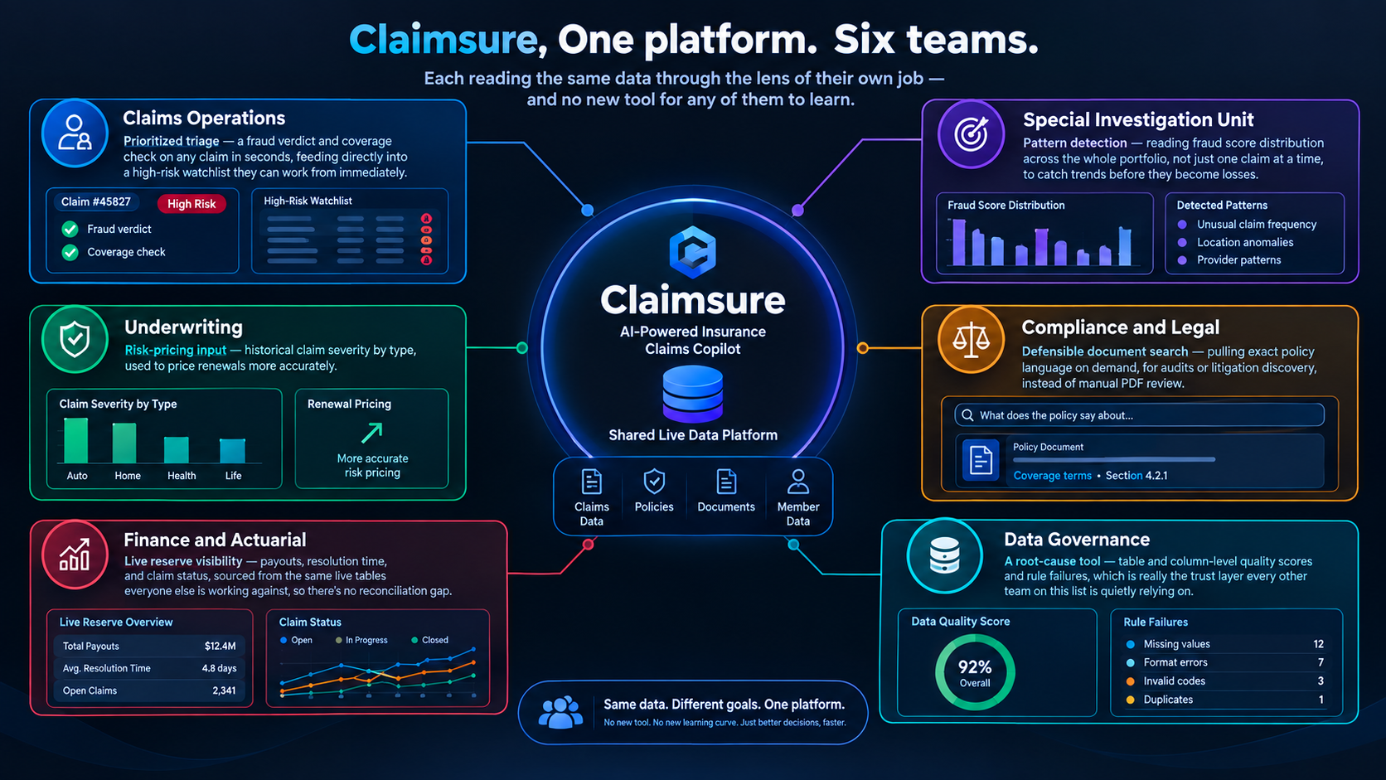
WHO IS THIS FOR?
Claims Fraud Triage Copilo | Snowflake Cortex

Slide 5
Architecture – End-to-End Data Flow
Streamlit-in-Snowflake (User Interface)
DATA_QUALITY Schema
DQ_SCORES • DQ_RULES
DQ_RESULTS • DQ_COLUMN_HEALTH
Cortex Agent (Orchestration & Reasoning)
Cortex Analyst (Insurance Analyst)
SQL via Semantic View → Structured Facts
Cortex Search (Policy Search)
Vector Search → Policy Document Clauses
INSURANCE_AI_HUB.ANALYTICS
CUSTOMERS | POLICIES | CLAIMS | BILLING | AGENTS
AT_RISK_POLICIES | PRICING | MARKET_TRENDS
INSURANCE_AI_HUB.DOCUMENTS
POLICY_DOCUMENTS | DOCUMENT_CHUNKS
(Embeddings for vector search)
Claims Fraud Triage Copilo | Snowflake Cortex

Slide 6






Entity Relationship Diagram — Insurance AI Hub
ANALYTICS DOMAIN
DOCUMENTS DOMAIN
DATA QUALITY DOMAIN
CUSTOMERS
PK CUSTOMER_ID
BILLING
PK BILLING_ID
FK POLICY_ID
FK CUSTOMER_ID
DOCUMENT_CHUNKS
PK CHUNK_ID
FK DOCUMENT_ID
DQ_RESULTS
PK RESULT_ID
FK RULE_ID
DQ_COLUMN_HEALTH
PK HEALTH_ID
POLICIES
PK POLICY_ID
FK CUSTOMER_ID
FK AGENT_ID
AT_RISK_POLICIES
PK RISK_ID
FK POLICY_ID
FK CUSTOMER_ID
DQ_RULES
PK RULE_ID
DQ_SCORES
PK SCORE_ID
POLICY_DOCUMENTS
PK DOCUMENT_ID
FK POLICY_ID
CLAIMS
PK CLAIM_ID
FK POLICY_ID
FK CUSTOMER_ID
AGENTS
PK AGENT_ID
PK Primary Key | FK Foreign Key | Solid lines denote direct parent-child relationships; dashed lines indicate cross-domain references.

Slide 7
Old Approach vs New Approach
✕ OLD WAY — Without ClaimSure
✓ NEW WAY — With ClaimSure
✕ Manually re-reading policy PDFs per claim
✕ Business users can't query claims data directly
✕ All claims queued equally, regardless of risk
✕ Data quality checked only by data engineering
✕ High call-center volume on “what's covered”
✕ A single static fraud score, no context
✓ Instant exclusion-clause lookup via Cortex Search
✓ Plain-English analytics via Cortex Analyst
✓ Low-risk claims fast-tracked automatically
✓ Conversational root-cause explanations for anyone
✓ Self-serve coverage answers, fewer calls
✓ Reasoned verdict combining score, history & policy text
⚡ ClaimSure doesn't just speed up lookups — it changes how claims get triaged entirely.

Slide 8

Expected Outcomes & Measurable Impact
Quantifiable business value delivered by AI-driven claims triage
80%
Claims Fast-Tracked
Low-risk claims identified instantly by AI — skip full manual review
100%
Consistency
Every claim gets the same checks every time, regardless of workload
0
New Infrastructure
Built entirely on Snowflake Cortex, Streamlit, and existing warehouse data
~90%
Triage Time Saved
Seconds for AI verdict vs hours of manual cross-referencing across systems
✦ Fraud Detection Accuracy
AI-scored fraud probability enables data-driven investigation prioritization.
✦ Cost Savings
Reduce fraud investigation team scaling needs — AI handles triage at any volume.
✦ Customer Satisfaction
Faster payouts for genuine claims — 80% processed without full manual review.
✦ Data Trust
Built-in Data Quality monitoring ensures AI verdicts are based on reliable, timely data.
⚡ Claims Fraud Triage Copilot — Powered by Snowflake Cortex for end-to-end operational efficiency.

Slide 9
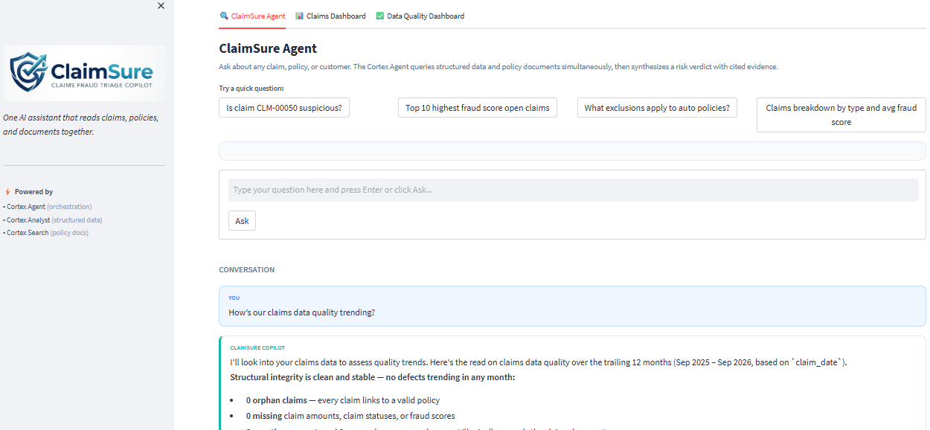
The interface: one chat, every question type
Streamlit APP User Interface (Agent)
Question asked: "How’s our claims data quality trending?"
⚡ Claims Fraud Triage Copilot — Powered by Snowflake Cortex for end-to-end operational efficiency.

Slide 10
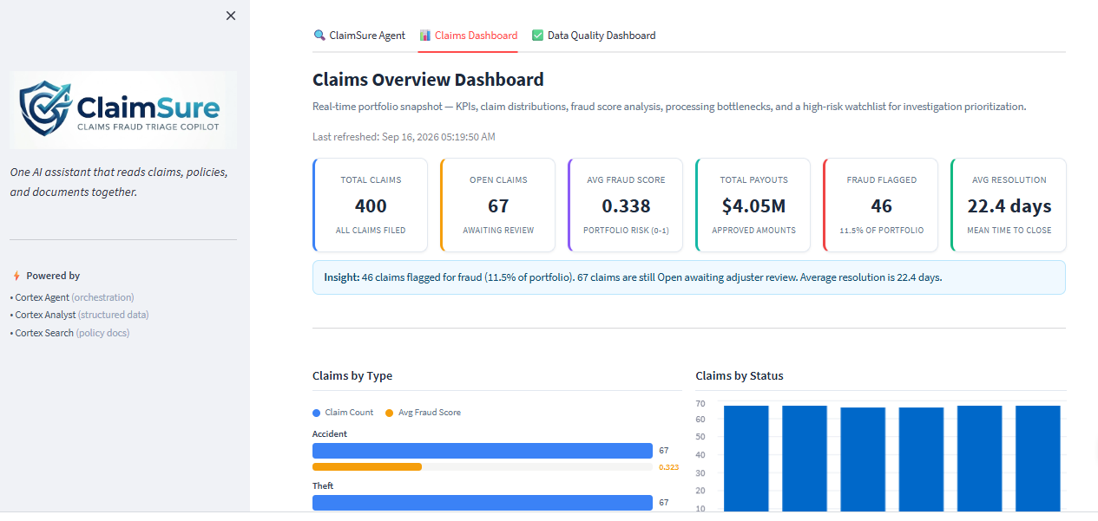
Claims Dashboard
Streamlit APP User Interface (Dashboard)
⚡ Claims Fraud Triage Copilot — Powered by Snowflake Cortex for end-to-end operational efficiency.

Slide 11
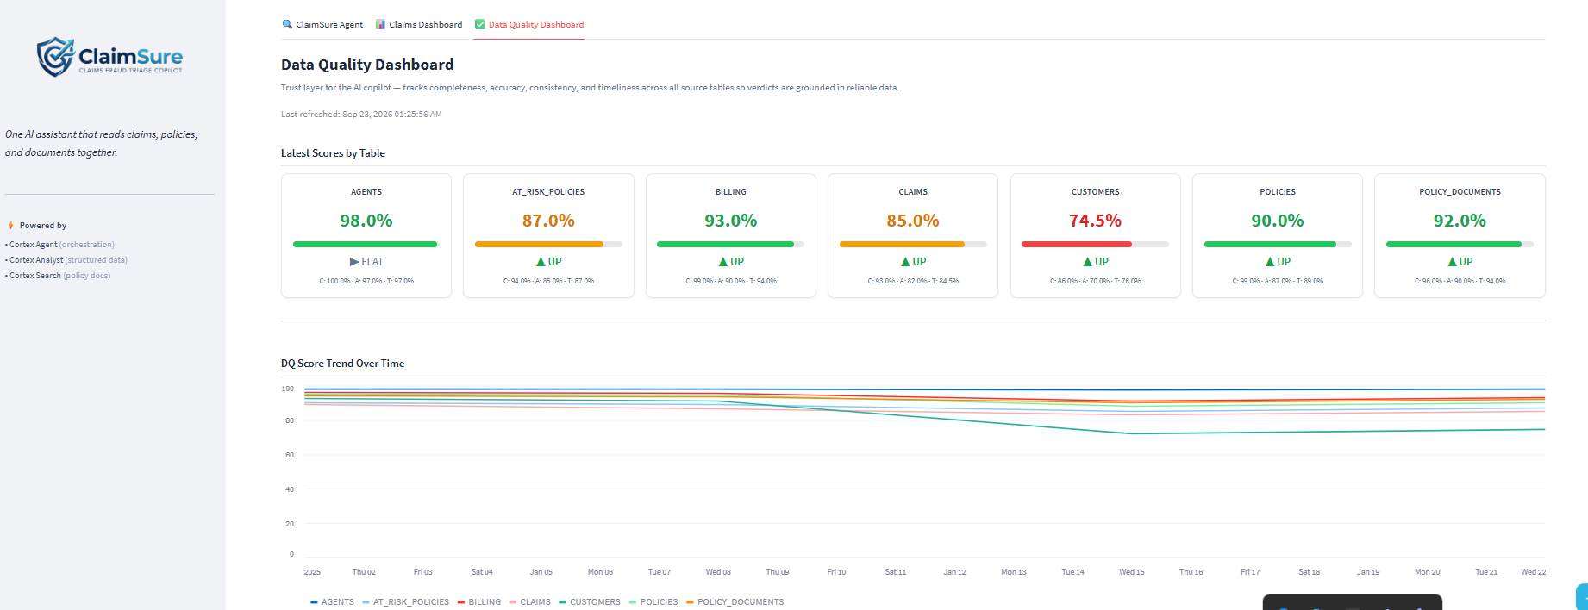
Data Quality Dashboard
Streamlit APP User Interface (Dashboard)
⚡ Claims Fraud Triage Copilot — Powered by Snowflake Cortex for end-to-end operational efficiency.

Slide 12
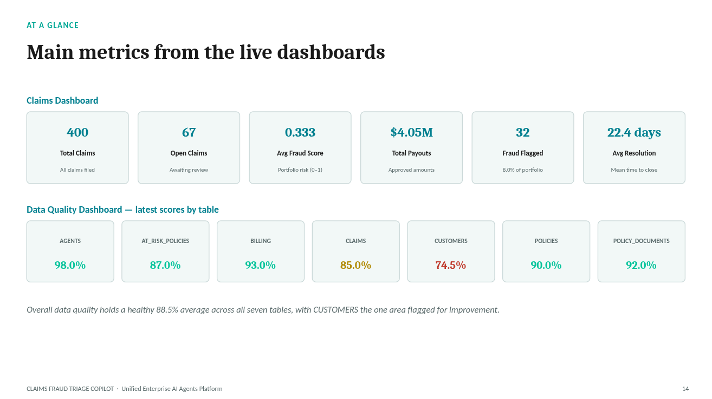
Main KPI Metrics
Streamlit APP User Interface
⚡ Claims Fraud Triage Copilot — Powered by Snowflake Cortex for end-to-end operational efficiency.

Slide 13
Worked Example — From Question to Verdict
“Claim CLM-4521 — is this a valid claim, and is anything about it suspicious?”
What Cortex Analyst Pulls Back
What Cortex Search Finds
Claim type - Water damage — residential
Claim amount - $18,400
Fraud score - 0.71 (elevated)
Policy status - Active, valid coverage window
Claims, last 6 months - 2 prior claims (same customer)
Retrieved clause — Section 4.2, Exclusions:
“Water damage originating from gradual seepage is not covered under this policy.”
Matched from POLICY_DOCUMENTS via Cortex Search over DOCUMENT_CHUNKS
— no manual PDF reading required.
HIGH RISK
• Claimed damage (gradual seepage) falls under a documented policy exclusion
• Customer has filed 2 similar claims in the past 6 months
• Fraud score of 0.71 is above the elevated-risk threshold
Adjuster action: escalate to fraud investigation queue — skip fast-track approval.
⚡ Plain-English risk verdict, with the evidence attached — in seconds.

Slide 14
Any Questions?
Questions, feedback, and next-step alignment welcome.
Discussion & Next Steps
help_outline
Questions
Deep-dive into Snowflake Cortex architecture, agent routing, or data quality controls.
rate_review
Feedback
Share insights on triage accuracy, fraud scoring thresholds, and adjuster workflow ergonomics.
alt_route
Next Steps
Align on pilot scope, timeline, MCP system integrations, and row-level security setup.
⚡ Claims Fraud Triage Copilot — A Unified Enterprise AI Agents Platform powered by Snowflake Cortex

